Slide 1

Project Title – Network Port Scanner
Student Name: Thatikonda Arjun
AICTE ID: STU68edc85df2a941760413789
College Name – GITAM University

Slide 2

PROBLEM STATEMENT
Manual network auditing is slow and prone to oversight, leaving systems vulnerable to exploitation due to a lack of rapid, automated visibility into open ports and services.

Slide 3
Project Description
The Network Port Scanner is a Python-based desktop application with a GUI that allows users to scan a target IP address or hostname for open TCP ports within a user-defined range. It connects to each port in the range, identifies open ones, and generates a detailed Port Scan Analysis Report — including the service name, protocol, and security implications of each open port. The tool also features a real-time progress bar, elapsed time tracking, and a stop function for user control.

Slide 4

WHO ARE THE END USERS?
Network Administrators – to audit and monitor their infrastructure
Cybersecurity Students & Researchers – for learning and ethical hacking practice
Penetration Testers – to perform reconnaissance during authorized security assessments
IT Support Teams – to troubleshoot connectivity and service availability issues
System Administrators – to verify firewall rules and exposed services
SOC (Security Operations Center) Analysts – to detect unauthorized or suspicious open ports during incident investigation and continuous network threat monitoring

Slide 5

Technology Used
Python – Core programming language
Tkinter – GUI framework for the desktop interface
Socket library – For TCP connection attempts and port probing
Threading – To run scans concurrently without freezing the UI
AI Analysis Module – For generating the Port Scan Analysis Report with security insights

Slide 6
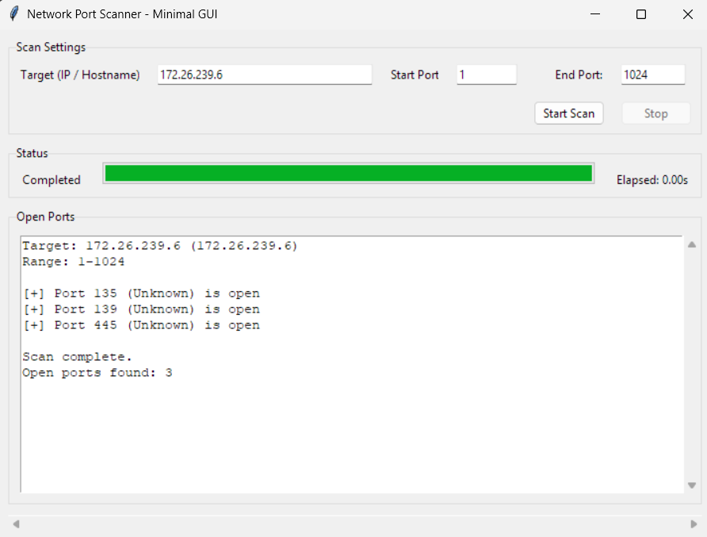
RESULTS
Demo Link

Slide 7
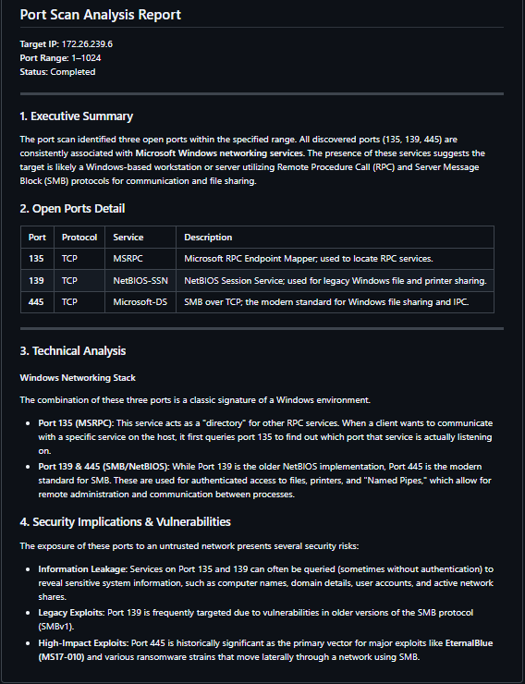
RESULTS
Demo Link

Slide 8

Certificate - Protection from browser attacks

Slide 9

Certificate - Introduction to System Security

Slide 10
GitHub link
ARJUN1675/Network-Port-Scanner

Slide 11
Thank you
.
.

